Slide 1


Can we predict cushioning perception from the mechanical properties of shoes?
M.Q. Salzano¹, G. Weir¹, J. Kuzmeski¹, J. Thompson², M.B. Trudeau², C. Ertel², K. Dear², S. Willwacher³, J. Hamill¹
¹University of Massachusetts Amherst, Amherst, MA, USA
²Brooks Running Research Laboratory, Seattle, WA, USA
³Offenburg University of Applied Sciences, Offenburg, Germany

Slide 2
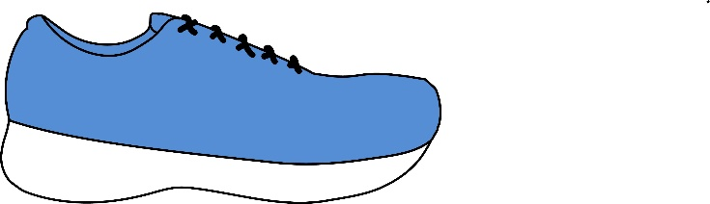
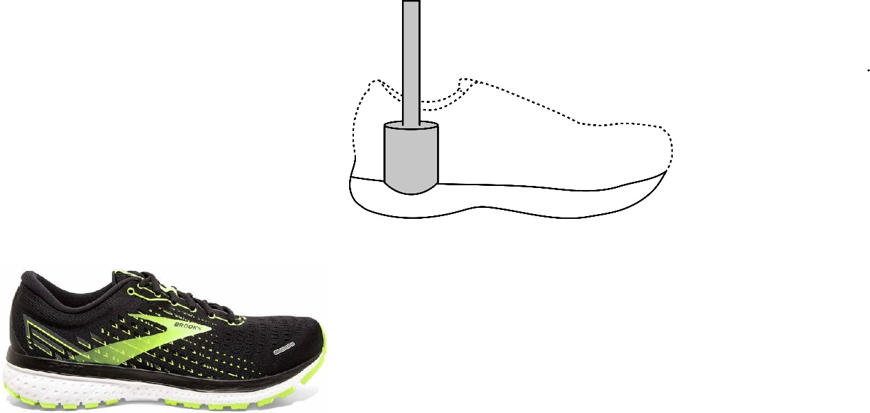
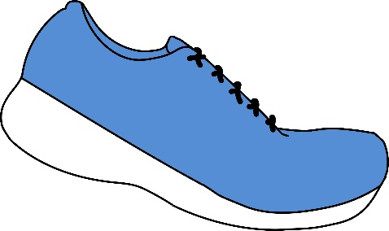
Mechanical properties often investigated for injury & performance…
may alter running biomechanics
effect on injury/performance inconclusive (Hoogkamer 2020, Burns & Tam 2019)
Midsole
Thickness
Midsole
Hardness & Resilience
body mass may have influence on injury risk (Malisoux et al. 2020)
more resilient foams & improved running economy (Worobets et al. 2014)
optimal stiffness may exist for individuals (McLeod et al. 2020)
carbon fiber plates & running economy (Ortega et al. 2021)
Longitudinal
Stiffness
Notes:
Footwear mechanical properties and their biomechanical effects are often investigated to find a relationship to injury and performance. For example, differences in midsole thickness may alter various biomechanical measures – such as contact time – but debates still remain on its influence on injury and performance related measures. Midsole hardness may also affect biomechanics, although the coupling of body mass and midsole hardness appears to have an influence on injury risk. It’s also been shown that more resilient midsole foams can result in improved running economy. Effects of longitudinal stiffness are also inconclusive, but research has shown than an optimal stiffness may exist for individuals. There is also uncertainty about if, and how much, the addition of carbon fiber plates improve running economy.

Slide 3
…though little known about perception and mechanical properties link
Cushioning often cited as one of the most desired features in a shoe (Schubert et al. 2011; Clifton et al. 2011)
Preference towards softer shoes (i.e. decreased midsole hardness) (Sterzing et al. 2012)
Torsional stiffness, heel-to-toe offset, and support also play a role in satisfaction of shoe (Miller et al. 2000)
Importance of other features may differ with sex (Clifton et al. 2011) & age (Schubert et al. 2011)
Notes:
While the literature is inundated with studies investigating footwear properties and biomechanics, little is known about the link between these properties and runner perception and satisfaction. Cushioning is often cited as one of the most desired features in a shoe, with a preference towards softer shoes, as measured by midsole hardness,. Other factors, such as torsional stiffness, heel-toe drop, and support features may also influence satisfaction, but the importance of specific features outside of cushioning may differ with age and gender

Slide 4
Purpose
Can we predict satisfaction of a shoe and willingness to purchase footwear from a shoe’s mechanical properties?
Tool to predict how well a shoe will be perceived based on its properties would be invaluable to footwear companies
What properties are most important for determining satisfaction or willingness-to-buy in a shoe?
Knowing relationships between properties and satisfaction would allow footwear manufacturers to possibly focus on just a few key parameters
Notes:
Therefore, we were curious if we could predict the satisfaction of a shoe and a runner’s willingness-to-purchase a shoe from its mechanical properties, in addition to a few other factors. This type of tool would be invaluable to footwear manufacturers in order to determine how well a new shoe may be received. We also sought to determine which properties are the most important for a runner’s satisfaction or purchase preference. This would allow footwear manufacturers to possibly focus on a few key parameters during research and development.

Slide 5
Database
Compiled across multiple studies in the Brooks Running Research Lab
Subjects - 119 unique runners
35 males, 83 females
66.0 ± 10.3 kg
1.68 ± 0.07 m
36.4 ± 8.8 years-old
Shoe mechanical properties
69 shoes
8 brands
Perception Scores
Degree of Satisfaction: 7-pt Likert scale (1: very dissatisfied; 4: neutral; 7: very satisfied)
Overall Satisfaction: degree of satisfaction transformed to a 3-pt Likert scale
(1: dissatisfied; 2: neutral; 3: satisfied)
Willingness-to-buy: Yes/No
Notes:
The data used in this study was taken from a database that was compiled across multiple studies in the Brooks Running Research Lab. The database contained information on subjects running in shoes with various mechanical properties and recording a perception score related to satisfaction. The database contained information from 119 unique runners, with 35 males and 83 females. Runners averaged 66 kg body mass, 1.68 m tall, and roughly 37 years-old. 69 shoes were tested across 8 brands. Perception scores included a degree of satisfaction, which was recorded using a 7-point Likert Scale – 1 representing very dissatisfied and 7 being very satisfied. We also transformed the 7-point Likert scale into a 3-point Likert scale. Scores of 1-3 on the original scale were recoded as a 1 to represent dissatisfied, neutral scores became a 2, and all scores above a 4 were recorded as a 3 for satisfied. Subjects also recorded if they would by the shoe.

Slide 6
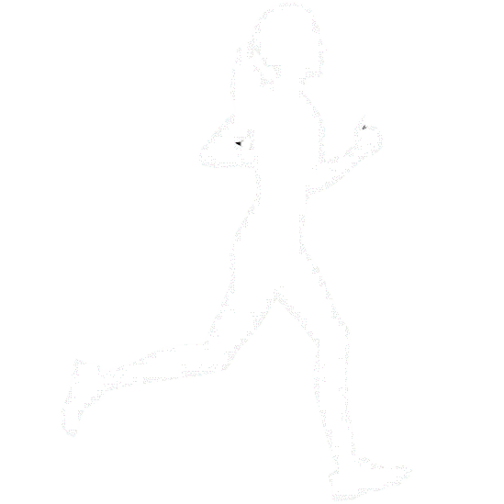
Database
Compiled across multiple studies in the Brooks Running Research Lab
119 unique runners
Shoe mechanical properties
Perception Scores
35 males, 83 females
66.0 ± 10.3 kg
1.68 ± 0.07 m
36.4 ± 8.8 years-old
69 shoes
8 brands
Degree of Satisfaction
Overall Satisfaction
Willingness-to-buy
Notes:
The data used in this study was taken from a database that was compiled across multiple studies in the Brooks Running Research Lab. The database contained information on subjects running in shoes with various mechanical properties and recording a perception score related to satisfaction. The database contained information from 119 unique runners, with 35 males and 83 females. Our runner cohort had an average body mass of 66 kg, height of 1.68 m, and roughly 37 years-old. 69 shoes across 8 brands were tested for their mechanical properties. We also recorded each runner’s perception to the shoes they ran in, noting their degree of satisfaction, overall satisfaction, and if they would purchase the shoe.

Slide 7
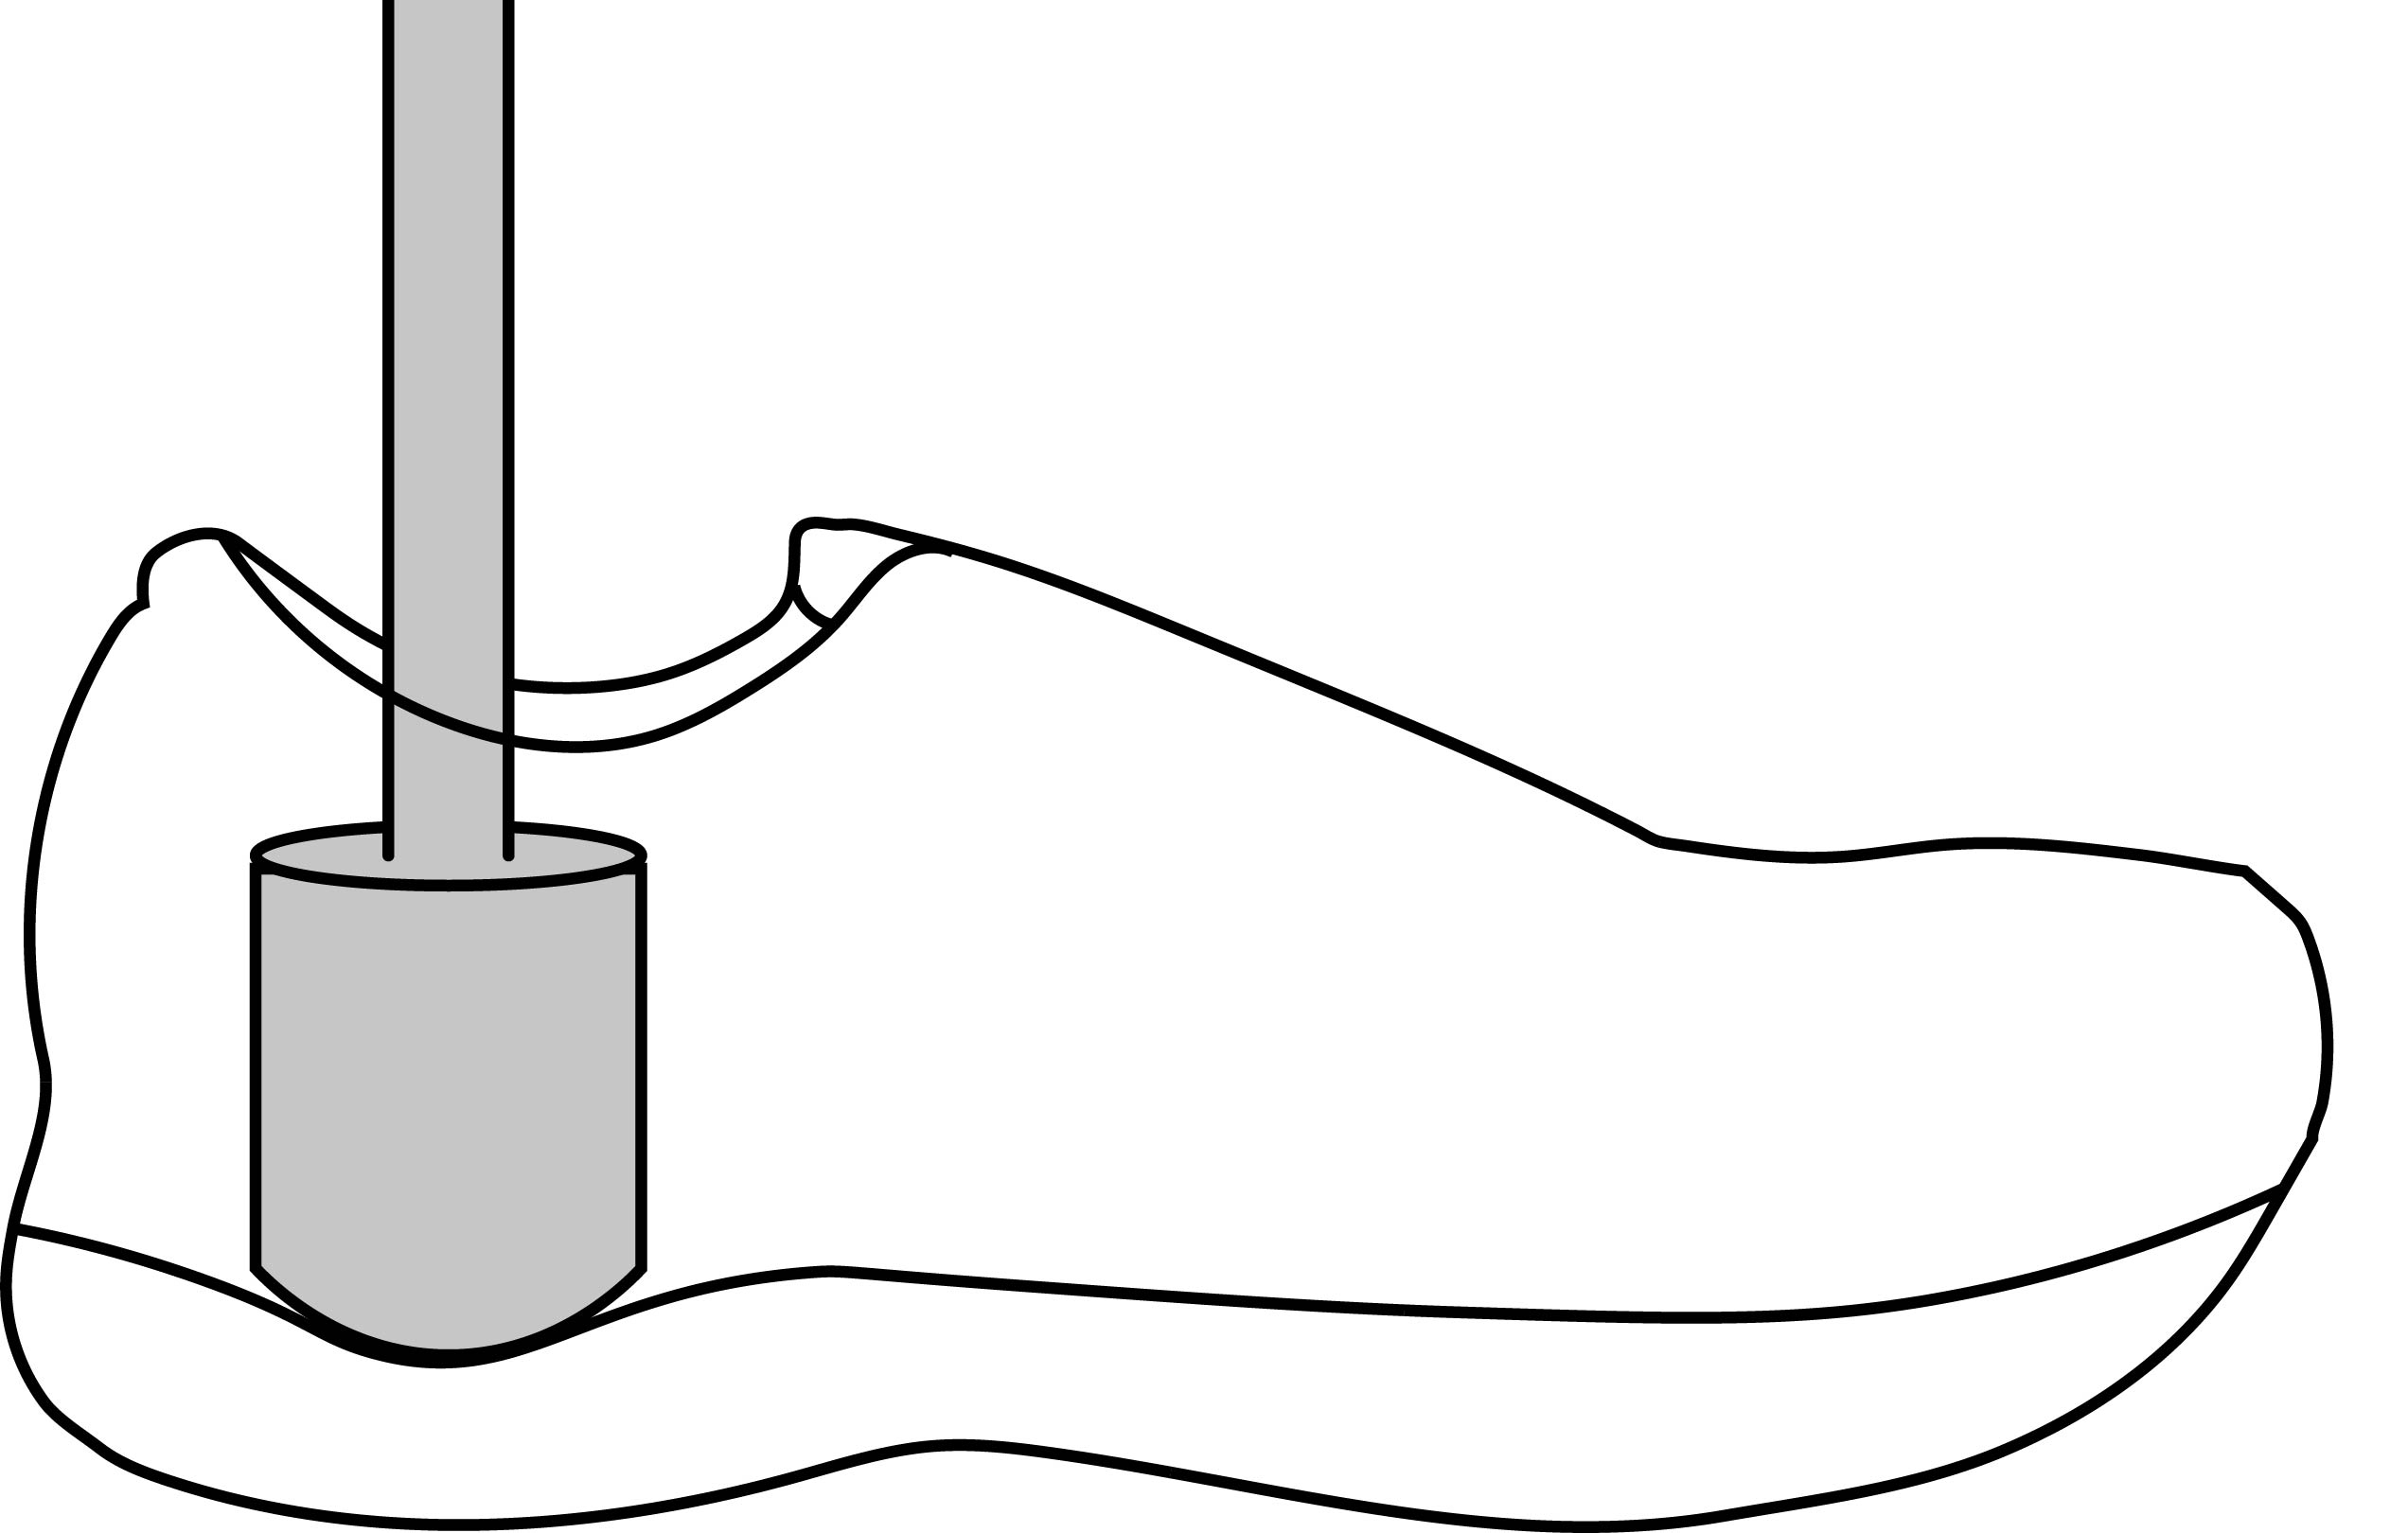
Mechanical Properties
*Durometer
Shoe Weight
Stability Shoe
*Gmax
*Time-to-peak
*Loading Rate
*Energy Return
* Tested at both heel & forefoot
ASTM F1976-13
Forefoot Flexibility
(Flex)
*Stack Height
Notes:
9 properties were recorded for each shoe, with some tested as both the heel and forefoot – denoted by an asterisk. An impact tester was used to determine midsole Gmax, time to peak, loading rate, and energy return, at both the heel and forefoot, using the ASTM standard. Heel and forefoot stack height, and forefoot flexibility were also measured. Midsole hardness was also tested using a handheld durometer. Weight of the shoe, and a shoe’s classification as neutral or stability were also recorded.

Slide 8
Perception Scores
Very Dissatisfied
Slightly Dissatisfied
Slightly Satisfied
Very Satisfied
Dissatisfied
Neutral
Satisfied
Degree of Satisfaction
Dissatisfied
Neutral
Satisfied
Overall Satisfaction
No
Yes
Willingness-to-Buy
Notes:
For each shoe that a runner ran in, we recorded various perception scores, specifically those related to satisfaction. We first asked if runners were satisfied with a shoe, using a standard 7-point Likert scale, with 1 representing ‘very dissatisfied’ and 7 representing ‘very satisfied’ – and we defined this as degree of satisfaction. In post-processing, we transformed these scores to a 3 point Likert scale to get overall satisfaction. This was done by recoding all ‘dissatisfied’ scores as 1, neutral as 2, and all ‘satisfied’ scores as a 3. We also asked the runners if they would purchase the shoe.

Slide 9
Predictive Models
Random Forest
Logistic Regression
Collection of decision trees to classify data and model data in complex manner
Sensitive to collinearity but robust against normality & outliers
Performs feature selection and determines variable importance but cannot determine relationships
Elastic net regularization handles collinearity and performs feature selection
Data needs to be centered & scaled, with outliers removed
Gives linear relationships among predictors
1
Probability
0
Notes:
Two types of predictive models were used for this study. The first type of model used was a random forest model, which is a collection of decision trees used to classify data and can model data in a complex manner. These types of models can be sensitive to high collinearity, but the data do not need to be transformed as the models are robust against normality and outliers. Random forests can also remove unnecessary predictors and determine variable importance, but we lose the ability to interpret relationships amongst predictors. The second type of model used was a logistic regression with elastic net regularization – which handles collinearity and also performs feature selection. The data do need to be centered & scaled and outliers must be removed. Logistic regressions also give linear relationships among the transformed predictors.

Slide 10
Models
Model 1: Degree of satisfaction (7-point Likert scale)
Model 2: Overall Satisfaction (Transformed Likert scale)
Model 3: Willingness-to-buy (0: No; 1: yes)
Random Forest – Full: All footwear properties + body mass, sex, age
Random Forest – Reduced: Removal of time-to-peak & loading rate
Logistic regression: All footwear properties + body mass, sex, age – outliers removed
Notes:
A total of 9 models were built for this study – 3 overall models, each using a different outcome, and 3 variations on each of those models. Model 1 was built to predict degree of satisfaction, with the 7 point Likert scale used as the outcome. Model 2 was built to predict overall satisfaction, using the transformed 3 point Likert scale. The 3rd model tested the idea of predicting if a person would be willing to purchase the shoe. Each of these models was built using 2 variations of the random forest model, as well as the logistic regression. The first random forest model used all footwear properties, in addition to subject characteristics like body mass, age, and sex. The reduced random forest model used the same predictors, except for time to peak and loading rate, as they were highly correlated with Gmax. The logistic regression model used the same predictor set as the full random forest model but eliminated 1 subject and 2 shoes as outliers

Slide 11
Work Flow
Full Dataset
80%
20%
10x
5-fold
CV
Training Set
Validation Set
80%
20%
Training
Subset
Testing
Subset
Build model
Test model
Final Model
Prediction Accuracy
All analyses performed in R – predictive models built using the “caret” package
Notes:
For each model, the full dataset was split into a training set and a validation set, using an 80/20 split. The training set was used build and train the model using 10 times 5-fold cross validation. With the CV protocol, the original training set was split into training and testing subsets, which were used to train and test the models being built, respectively, within each CV repeat. The model with the best accuracy was deemed the final model, and its accuracy with new data was tested against the original validation set, and it’s this accuracy that is reported in our results. All analyses were performed in R, with models built using the “caret” package.

Slide 12
Most runners were satisfied with the shoes, but not enough to buy
Degree of Satisfaction
Overall Satisfaction
Willingness-to-buy
Notes:
Across all shoes and runners, we found that a majority of responses showed satisfaction in the shoes, shown here on the left in white, red, and grey, as well as in red in the middle plot. However, that satisfaction did not translate to a desire to buy the shoes, as most responses indicated that runners would not purchase the shoe tested.

Slide 13
Degree of satisfaction cannot be predicted from footwear properties
Model 1: 7-point Likert scale
% majority response
Notes:
Here, we have the accuracy of the models, shown here on the Y axis, used to predict degree of satisfaction in the shoe. Our results show that no matter which type of model is used, predicted degree of satisfaction is not better than the no information rate, which is the highest proportion of responses in the validation set and refers to the accuracy of classifying every data point as that outcome.

Slide 14
Overall satisfaction cannot be predicted from footwear properties
Model 2: 3-point transformed scale
% majority response
Notes:
Similar results are seen for predicting overall satisfaction, using the transformed 3 point satisfaction scale. Neither random forest model nor the logistic regression model was able to provide an accuracy better than the no information rate.

Slide 15
Footwear properties can predict willingness-to-buy with ~65% accuracy
Model 3: Willingness-to-buy
* p < 0.05
% majority response
*
*
*
Notes:
In predicting whether a runner would be willing to purchase a shoe, we found that all 3 models, both random forests and the logistic regression, were able to achieve prediction accuracies significantly greater than the no information rate, which was evaluated with a binomial test. The prediction accuracy was fairly consistent across all 3 models, hovering at around 65%.

Slide 16
Importance of footwear properties were inconsistent across models
Random Forest
Logistic Regression
Rank | Full | Reduced
1 | Age | Age
2 | Body Mass | Body Mass
3 | Heel Gmax | Heel Gmax
4 | Heel Loading Rate | Heel Stack
5 | Forefoot Gmax | Forefoot Gmax
Coefficient | Variable
-0.334 | Heel Energy Return
-0.332 | Heel Gmax
-0.239 | Stability
-0.228 | Forefoot Gmax
-0.116 | Flexibility
Eliminated:
Stability (from both)
Eliminated:
Heel stack, heel durometer, forefoot energy return, time-to-peak (heel & forefoot), loading rate (heel & forefoot), sex, body mass
Notes:
From the last set of models, we also noted the importance of variables for each model. For brevity, I am only showing the top 5 predictors for each model, as well as those eliminated. There was some consistency between the full and reduced random forest models in the top 5, with the only difference being in the 4th spot – Heel LR in the full and heel stack height in the reduced. Although the influence on TTP and LR did provide inconsistencies in the rankings farther down. Both models did eliminate classification as stability shoe as a predictor. Variable importance in logistic regression, shown by their coefficient), was very different than the random forests, however Gmax at the heel and forefoot remained important predictors. It’s also worth noting that TTP and LR were eliminated from the models, which may give support for using the reduced random forest model over the full model.

Slide 17
Footwear properties may be limited in their predictive potential
Footwear properties used here do not predict satisfaction
Could be due to use of Likert scale as opposed to visual analogue scale
Footwear properties predict willingness-to-purchase better than random guessing
Other features in shoes not listed could be impairing predictive performance
Incorporate other factors, such as fit or runner’s goals, into model to improve prediction?
Gmax consistently found to be a top 5 predictor across all models
Agrees with previous research that softer shoes are preferred
Notes:
Overall, we found that footwear properties are limited in their predictive potential. Degree of satisfaction or overall satisfaction cannot be predicted with the footwear properties and subject characteristics used in this study. This could possibly be due to the use of a Likert scale, whereas a visual analogue scale or rating scale may be more accurate in reflecting level of satisfaction. We did find that the footwear properties in this study can predict a runner’s willingness-to-purchase a shoe better than random guessing, but the 65% accuracy is still quite low. It could be that not incorporating other properties, like torsional stiffness, could be impairing performance. Adding other factors, such as the fit of the shoe, could improve performance, as well as something like a runner’s goals – runners focused on performance have different preferences than those focused on leisure. However, we did find that midsole Gmax consistently appeared a top 5 predictor across all models, indicating its importance. Its negative coefficient in the logistic regression also suggests softer shoes are preferred, which agrees with previous literature.

Slide 18
Footwear Personalization
1. Predicting satisfaction in a shoe from footwear properties alone may not be feasible
2. Predicting potential purchase from footwear mechanical properties remains limited
Future models could focus on more aspects of personalization in addition to body mass, sex, and age:
Foot geometry
Finances
Goals
Shoe Preferences

Slide 19
THANK YOU
Contact: msalzano@umass.edu
This study was funded by a grant from Brooks Sports, Inc.

