Slide 1


Moment Arm Plasticity in Response to Loading History During Growth
Matthew Q. Salzano
IGDP – Integrative and Biomedical Physiology
Muscle Function & Locomotion Lab | Biomechanics Lab
Notes:
THINGS TO DOUBLE-CHECK AND LOOK UP:
p-values for both mixed models
% differences in means at 3 noted angles

Slide 2
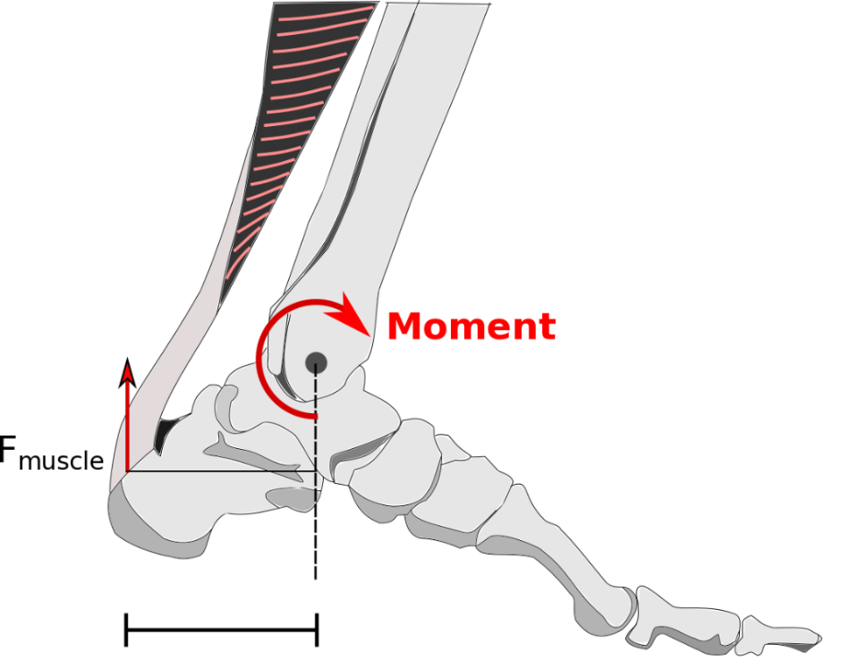
Musculoskeletal plasticity to loading
Muscle: CSA, fiber length
Tendon: CSA, stiffness, modulus
Bone: strength, length
Notes:
Moment arms are one of the fundamental elements of the musculoskeletal system that help determine locomotor function. They affect muscle force-length-velocity dynamics and moments produced around joints. However, despite known plasticity of other elements of the musculoskeletal system, such as muscle, bone, and tendon, it is currently unknown how, or even if, moment arms respond to loading protocols.

Slide 3
Musculoskeletal plasticity to loading
✓
✓
✓
?
Notes:
It’s been well-established that the musculoskeletal system is plastic in response to the loads it experiences. Muscle will either hypertrophy or atrophy in response to increased or decreased loads, respectively, while fiber length changes may be dependent upon type of exercise. Bone strength responds similarly to muscle size, while bone length changes are fairly ambiguous. Tendon size, stiffness, and modulus will also either increase or decrease depending on load level as well. At the crossroads of these elements lies the moment arm, which helps determine muscle dynamics and force production at the joint. However, despite its importance, its plasticity in response to loading has yet to be established.

Slide 4

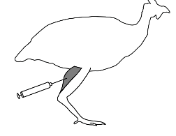
Study Design
4 weeks – 6 months
load level
Exercise (n = 8)
Large circle pen
Spontaneous & motivated
movement
Jumps to perch
Sedentary (n = 7)
Small pens
Restricted ability to
walk, run, & jump
Botox (n = 8)
Small pens
Restricted ability to
walk, run, & jump
Bilateral injections in plantarflexors (4x)
Notes:
Here, we aim to investigate moment arm plasticity using an avian bipedal model during the growth phase, which is when bone appears to be most sensitive to loading. We split birds into 3 groups in order to obtain a spectrum of load level. We had an exercise group that was allowed to freely roam around a large pen and jump to multiple perches. A sedentary group was housed in a small pen with a low netting to restrict movement and discourage jumping. Finally, we had a botox group housed similarly to the sedentary group, but also received bilateral injections of botox every 5 weeks into both gastrocnemius muscles to induce more restricted movement. The protocol lasted from when the birds were aged 4 weeks until they were 6 months of age.

Slide 5
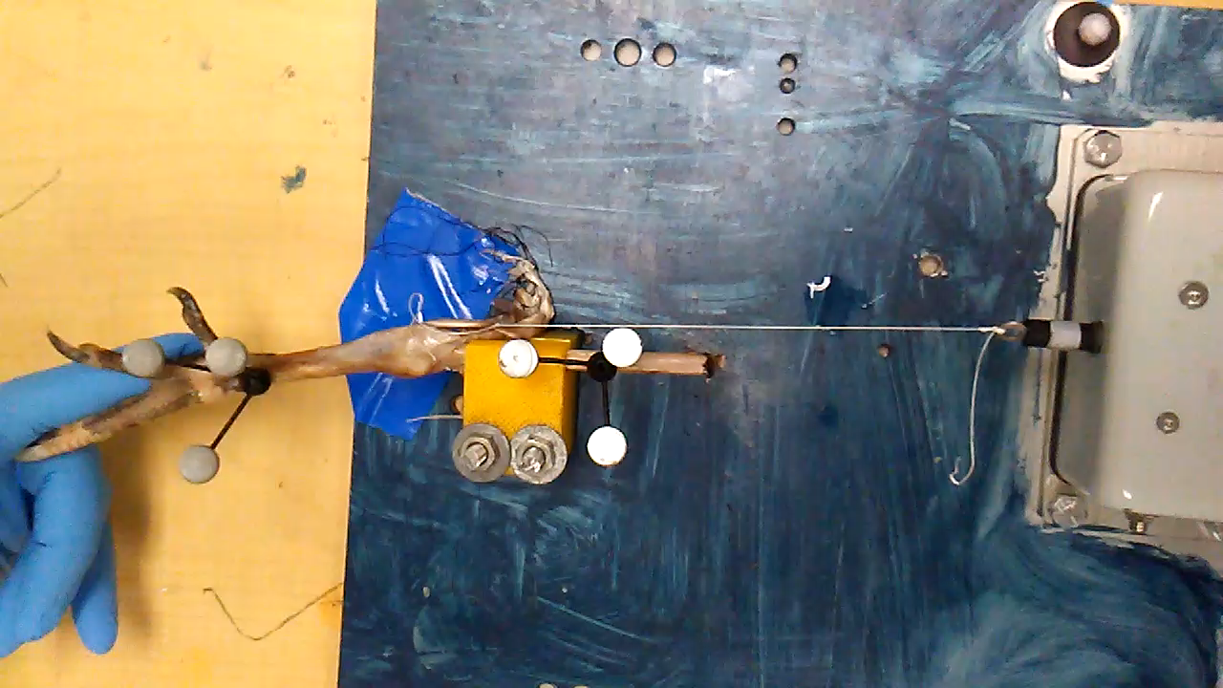
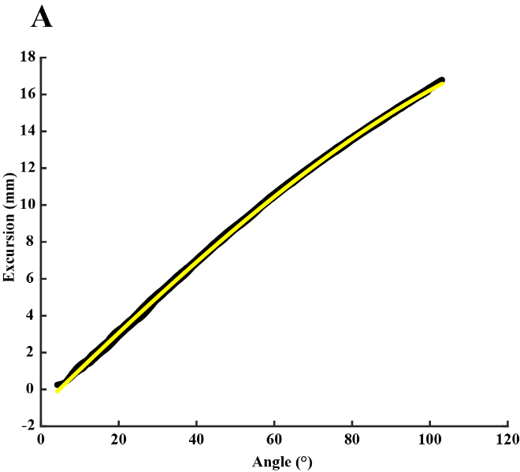
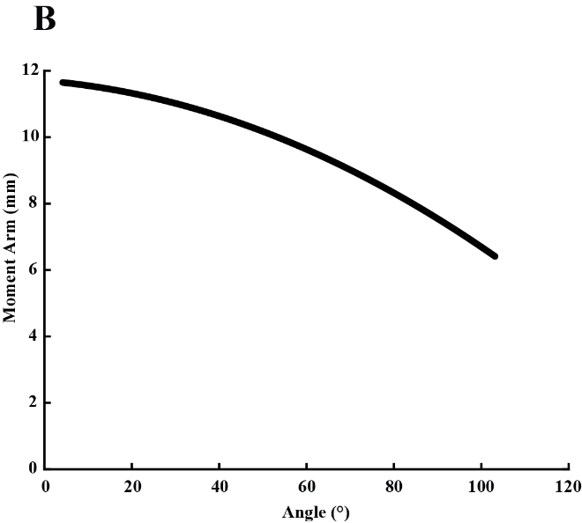
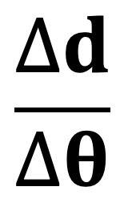
Tendon travel protocol to measure moment arm
Motion
Capture
Finite Helical Axis
Joint Angles
Moment Arm
+ Excursion
Notes:
To measure moment arm, we used the tendon travel protocol. After sacrifice and dissection, we attached clusters of retroreflective markers to the bones of the limb, and held the limb firm with a clamp on the tibia. The Achilles tendon was attached to a linear transducer to measure tendon excursion, while the tarsometatarsus was moved so as to rotate the ankle through roughly 60 degrees of motion. From the motion capture data, we were able to calculate a finite helical axis at the ankle, and then joint angles, which when paired with excursion data, allowed us to get moment arm. We then ran a mixed effects model to determine the effect of group on moment arm and any interaction between group and angle.

Slide 6

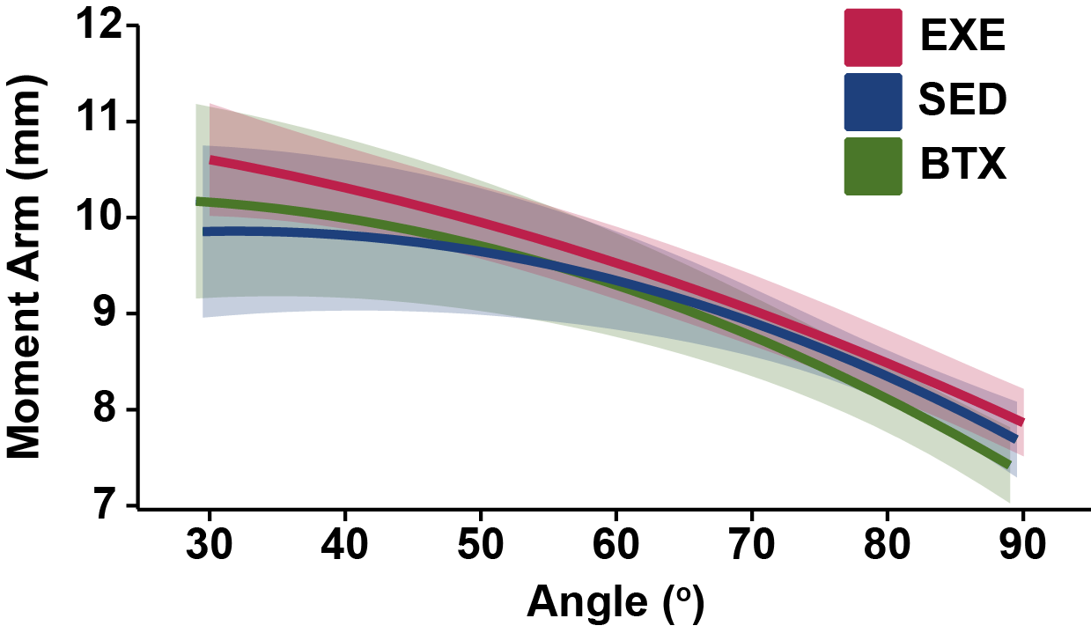
Significant interaction and group effect
Notes:
This line graph shows average moment arm for each group over the measured angle range, with the shaded region showing +/- 1 SD. Despite overlapping SD, we found that when angle was treated as a continuous variable, there was a significant Group x Angle effect and a significant Group effect. The exercise control group appeared to have consistently larger moment arms, while the sedentary group appeared to have a different moment arm vs angle relationship.

Slide 7
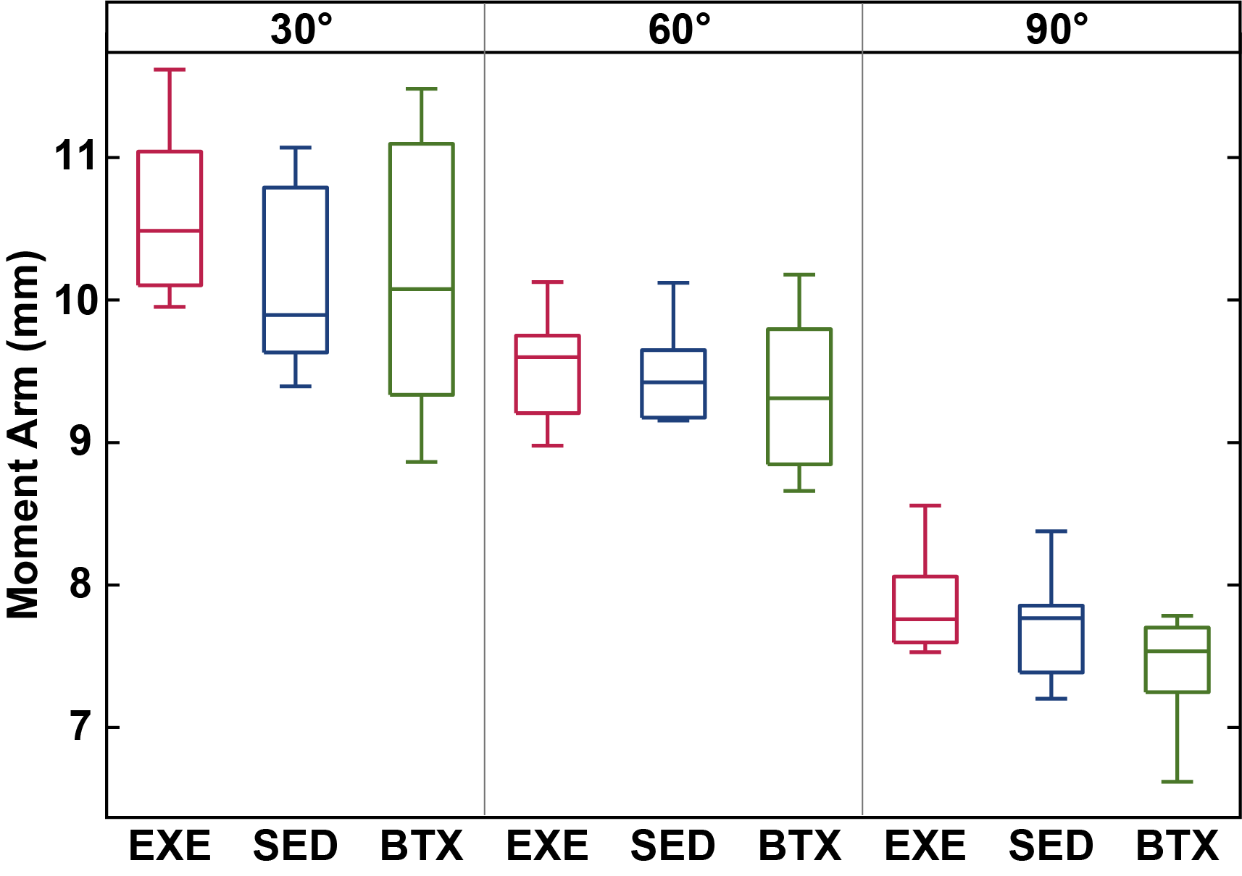
No significant interaction nor group effect
Notes:
Here, using box plots, we broke the moment arms down into the extremes and middle of the angle range. When treating angle as a categorical variable, we found no significant interaction or Group effect.

Slide 8
Possible moment arm plasticity in response to loading history?
No significant difference in mean comparisons
SED slope significantly different than EXE and BTX
EXE curve appears shifted up compared to SED and BTX
Limitation
Differences in load between groups may not have been as large as intended
Notes:
Since the data are bit ambiguous, which makes us hesitant to fully conclude that moment arms are plastic, but rather to say that evidence suggests they could be. We saw no significant difference in mean comparisons, but we did see that the sedentary slope was different that EXE and BTX and that EXE seems to be larger than the other two.
A major limitation is that we our botox treatment may not have worked as intended and that there was not a large enough difference in loading across all groups.

