Slide 1

High-Acceleration Training During Growth Increases Optimal Fiber Lengths in an Avian Bipedal Model
Matthew Q. Salzano¹, Suzanne M. Cox², Stephen J. Piazza², & Jonas Rubenson^{1,2}
Biomechanics Lab
¹IGDP – Integrative and Biomedical Physiology
²Department of Kinesiology, The Pennsylvania State University
University Park, PA
Notes:
Biomechanics lab

Slide 2
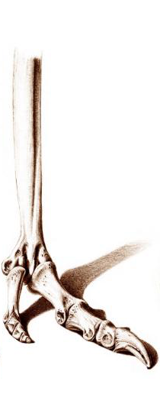
Musculoskeletal diversity: form & function
Digitigrade
(speed / economy)
Plantigrade (weight support)
Notes:
Terrestrial vertebrate limbs exhibit great variation in shapes and sizes, which is often matched to their locomotor function. For example, slender legs and digitigrade gait are seen in many animals that are well-suited for running. Thick legs and a plantigrade gait are well-suited for animals that carry a lot of weight.

Slide 3
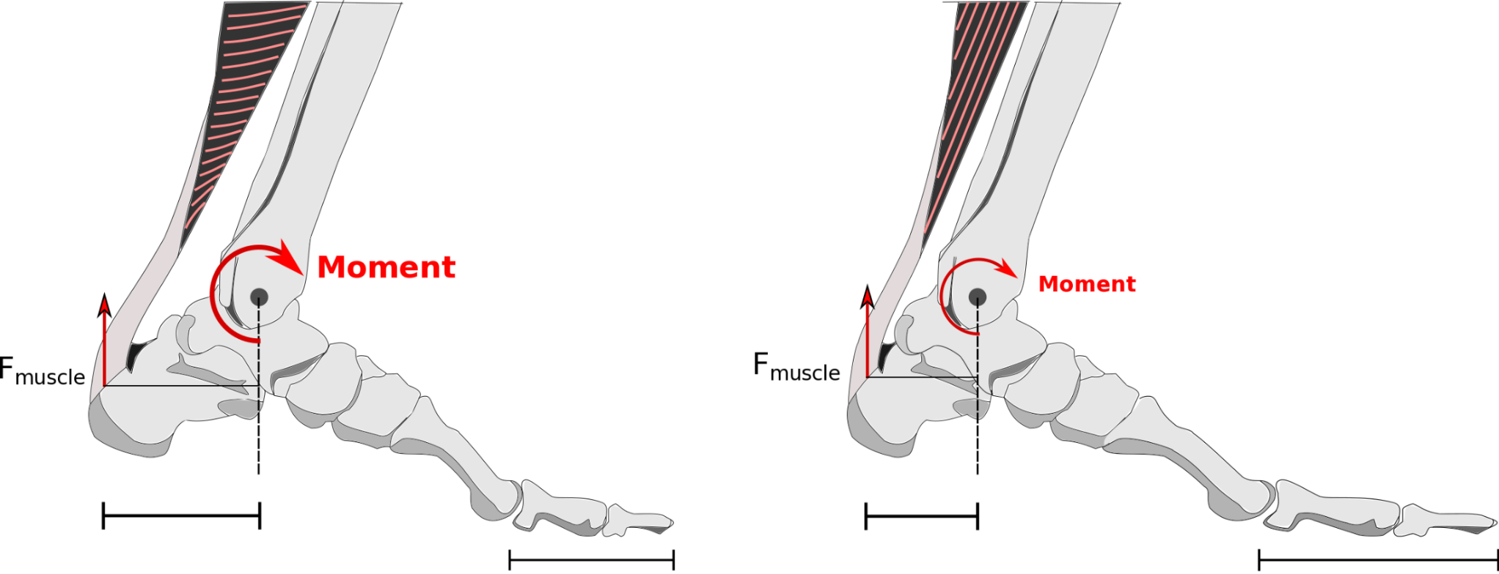
Musculoskeletal form & function in humans
Non-Sprinter
Sprinter
Longer fascicles,
Smaller pennation angle
(Abe et al. 2000)
Shorter heel
(Baxter et al. 2012)
Longer toes
(Baxter et al. 2012)
Notes:
Musculoskeletal diversity, albeit less drastic, is also evident in humans and is beginning to be understood in terms of structure and function. Take the classic example of a sprinter. Previous studies found to them have shorter heels, and thus a smaller plantarflexor moment arm, and also longer toes than non-sprinters. They have also been shown to have longer fascicles and smaller pennation angles in their gastrocnemius and vasti muscles. But why would these morphological differences benefit the sprinter, or more generally, why would these properties benefit high acceleration movements?

Slide 4
Acceleration: Long fibers and small moment arms enhance force generation
Short fascicle length
Large moment arm
F
F
[Insert animations showing force-length-velocity effects of fiber length and moment arms]
Long fascicle length
Large moment arm
L
V
Long fascicle length
Small moment arm
Notes:
First, recall that muscles are constrained by their force-length and force-velocity properties. They have higher force capacity at an optimal length and force generation drops off at shorter or longer lengths. Force generation also decreases as shortening velocity increases.
To illustrate how longer fiber length and smaller moment arms can benefit acceleration let us look at some hypothetical muscles. We’ll say that this first muscle, with a short fiber length and large moment arm represents your average muscle fiber. As joint moves through a given range of motion, the muscle fiber shortens and lengthens, generates force based on it’s F-L-V properties. Let’s compare this to a muscle with longer fibers due to more sarcomeres in series. Note, the peak force has not changed. But, over the same range of motion, smaller length changes in each sarcomere result in a smaller overall muscle length changes and slower shortening velocity, thereby maintaining higher force levels. This effect can be further exaggerated with a smaller moment arm, which causes even smaller muscle length changes and slower shortening velocities.
So while longer fascicles and smaller moment arms don’t increase peak force generation, they do allow for muscles to maintain higher force generations through a given range of motion. This can be crucial for effective force and power generation in movements requiring high accelerations

Slide 5

Musculoskeletal morphology:
‘Nature vs. Nurture’
?
Notes:
These differences in human musculoskeletal morphology raise an interesting, and unresolved, question: are they due purely to genetics? Or, can activity during growth influence morphology in adulthood? And if so, do these changes persist after training and growth cease? Put in the context of our sprinters, are the Usain Bolts born or made? We know muscles are plastic and adapt to training, but the literature addressing musculoskeletal morphology is severely lacking in controlled studies across growth periods, hampering our ability to answer these important questions. Which leads us to the purpose of this study.

Slide 6
Aim & Hypothesis
Aim: To explore whether exercise-induced developmental plasticity influences adult muscle form & function
Effect of high-acceleration training during growth on fascicle length
Notes:
This study is part of a larger study exploring if exercise-induced developmental plasticity influences adult musculoskeletal form and function. This specific study is investigating a sub-set of this project and is focused on the effects of training during growth on muscle fiber length and architecture.

Slide 7
Aim & Hypothesis
Hypothesis: High-acceleration training leads to longer muscle fascicles better suited to power generation
Sedentary
Exercise
[Insert F-L-V animation for short fibers]
[Insert F-L-V animation for long fibers]
Notes:
We hypothesize, based on the evidence from sprinters, that high-acceleration training will lead to longer muscle fibers, which are better suited to force production and power generation during acceleration.

Slide 8
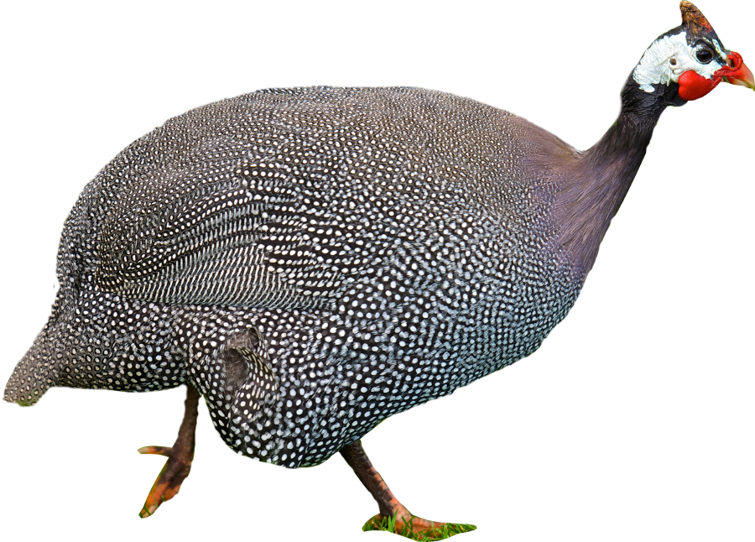
Experimental Model
***Human-based study would provide less control***
Helmeted Guineafowl
(Numida meleagris)
Bipedal
Rapid growth (~ 4 mo)
Controlled exercise interventions
Amenable to invasive procedures
(NZ Birds Online)
Notes:
Ideally, we would love to study this in humans, but can you imagine following a group of children through from toddlers to adults and having them adhere to a training protocol for 15+ years!! It would be an ethical and logistical nightmare. For this reason we adopted an animal model, the helmeted guinea fowl, to study these questions. This species has become a popular model for studying muscle and locomotor function due to features that make them ideally suited for this study. First, these birds are great bipedal runners, with similar overall patterns of joint mechanics to humans. They grow very rapidly, reaching full maturity within a few months, making controlled longitudinal growth studies possible. They are also amenable to invasive procedures to allow more in-depth looks at their muscles and bones.

Slide 9

Study Design
4 weeks – 14 weeks
Exercise (n = 15)
Large dual-circle pen
  0.35 m² per bird
Spontaneous & motivated movement
Jumps to perch
Sedentary (n = 15)
Small, square pens
  0.15 m² per bird
Restricted movement
Notes:
For this study, we utilized 30 guineafowl, which at 4 weeks-old, were split evenly into exercise and sedentary groups. The exercise birds were house in a large, dual-circle pen to allow for plenty of movement, as well as perches for them to jump upon. Each circle also had a rotating boom that turned on for 10 minutes every hour during the lighted hours to further encourage movement. The sedentary birds were housed in small, square cages to restrict movement.

Slide 10
Exercise Protocol
4 weeks – 14 weeks
[Video too large to display]
Exercise
  30 min 4x/wk forced exercise
Sedentary
  No forced exercise
Notes:
We also subjected the exercise group to 30 minutes of training, 4 times per week. This involved ‘encouraging’ all of the birds around one of the circles, which resulted in high-acceleration bursts of movement that required hurdling obstacles. This protocol lasted for 10 weeks, until they reached 14 weeks of age, which wasn’t quite full skeletal maturity but close; at which time they were sacrificed .

Slide 11
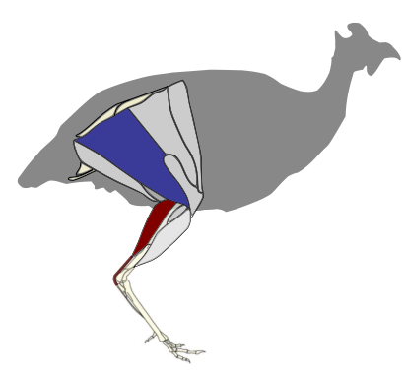
ILPO & LG - Two functionally distinct muscles
Iliotibialis lateralis pars postacetabularis (ILPO)
  Hip & knee extensor
  Long, parallel fibers
  Active shortening and lengthening during running (Carr, Ellerby, Rubenson,& Marsh 2011)
Lateral gastrocnemius (LG)
  Ankle plantarflexor & knee flexor
  Short, pennate fibers with long tendon
  Small length changes in running (Roberts et al. 1997, Daley & Biewener 2003)
(modified from Gordon, Rankin, & Daley 2015)
Notes:
To analyze changes in muscle morphology, we focused on to two functionally distinct muscles in the guineafowl hindlimb to determine if acceleration training has different effects in muscles with distinct fiber architecture and function. The first, is the ILPO. The ILPO is a large muscle on the lateral thigh with long, parallel fibers that acts as a hip and knee extensor. Our group has previously shown that this muscle undergoes large length changes during running. The second muscle is the lateral gastrocnemius, or LG. Similar to in humans, it has short, pennate fibers coupled with a long tendon, and its major function is as an ankle plantarflexor. During running, this muscle acts almost isometrically during running, with little to no length changes.

Slide 12
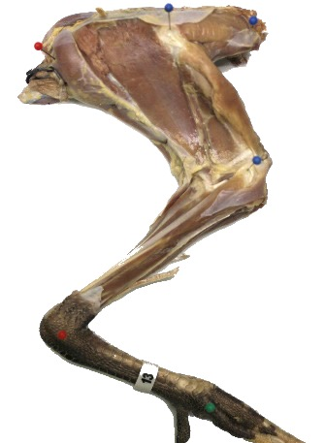
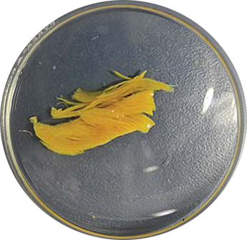
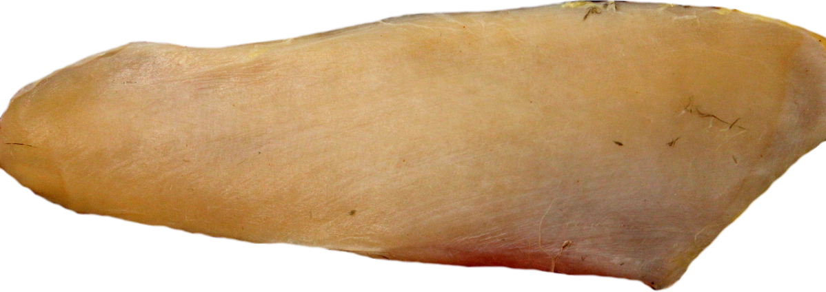
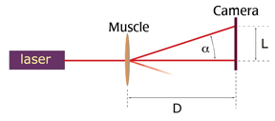
Muscle Analysis Protocol
1_{a}
1_{b}
2_{a}
2_{b}
3_{a}
1_{c}
3_{b}
2_{c}
3_{c}
Formalin-fixed / fresh-frozen dissections
Nitric acid digestion; fascicle length measurements
Laser diffraction; sarcomere length measurements
3 / 9-measurement per muscle
Notes:
We first dissected limbs off the bird and formalin-fixed them in a standard position. The ILPO and LG were then dissected off, and three sections of each muscle were isolated and used for fascicle analysis. Each section was digested in nitric acid and fascicles were teased out allowing length measurements via digitizing photos. Fascicles were mounted on slides for laser diffraction to measure sarcomere lengths, allowing us to compute optimal fiber lengths.
Although fascicle lengths were of primary interest, we also compared muscle mass, muscle PCSA, and pennation angles.

Slide 13
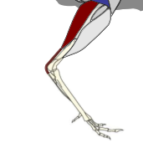

Sedentary birds were larger overall
Body Mass
Muscle Mass
Limb Length
1.45
*
16
LG
*
290
14
1.35
280
12
kg
g
mm
1.25
10
270
8
260
But no difference in body composition!
But ILPO PCSA smaller in exercise birds!
1.15
6
ILPO
250
Ex.
Sed.
Ex.
Sed.
Ex.
Sed.
Ex.
Sed.
Notes:
Briefly, we found that our sedentary group of birds, shown in white, were larger overall than our exercise birds, shown in black. At the end of the protocol, the sedentary birds were approximately 10% heavier than the exercise birds, though this was not due to fat as body composition between the two groups was similar. Despite differences in size, raw and normalized muscle mass were not different between groups though PCSA was smaller in exercise birds). We also found that sedentary birds had significantly longer hindlimbs than the exercise birds by about 3%.

Slide 14
Length changes were seen in ILPO but not LG
Optimal Fascicle Length
Normalized Optimal Length
100
*
*
80
LG
0.3
LG
60
mm
Fascicle length / limb length
0.2
40
0.1
20
ILPO
ILPO
Ex.
Sed.
Ex.
Sed.
Ex.
Sed.
Ex.
Sed.
No differences in pennation angle in either muscle
Notes:
Our main findings related to the differences in muscle fascicle lengths . For clarity and purposes of time, only the results of the middle sections of the muscles are shown here. Consistent with our hypothesis, we found that the exercise group had 24% longer fascicles in the ILPO. Contrary to our hypothesis, however, we did not see any differences in fiber lengths in any portion of the LG. For clarity, only the middle sections of the muscles are shown here.
But remember that the sedentary birds also had longer legs. When the fascicle lengths were normalized to leg length, the differences were even more pronounced in the ILPO. The fiber lengths in the exercise and sedentary group LG remained similar after length normalization.
(“middle portion is representative”)

Slide 15
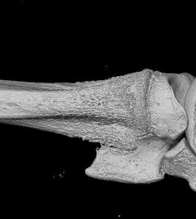
Summary of Results
[Insert F-L-V animation for long fibers]
ILPO
  Hip & knee extensor
  Long length changes during running
  Similar muscle masses but longer fascicles and smaller PCSA
  → optimized for power over isometric force?
LG
  Ankle extensor
  Small length changes during running
  Similar muscle masses + similar fascicle length
  → no difference in function?
[Insert F-L-V animation for short fibers]
    Smaller plantarflexor moment arms? (Salzano, Piazza, & Rubenson 2016)
Notes:
So, to the best of our knowledge, this the first study to illustrate that fiber lengths can increase as a result of acceleration training during growth. These adaptations are consistent with our theory of muscle fiber length and F-L-V effects. Our results also offer new burning questions: why did only the ILPO and not the LG change despite both being exercised? The answer may have to do with the function of each muscle. The ILPO undergoes large length changes during, so it makes sense that it would adapt by lengthening its fascicles to accommodate F-L-V constraints. In fact, the change in fascicle length with no change in muscle mass and lower PCSA suggests a preference for power, needed for short, quick bursts of energy like jumping or sprinting over isometric force capacity. The LG is a muscle that acts more isometrically during running, so changing fascicle length, would be of less benefit. Also, the similar muscle masses and fascicle length between the two groups suggests no functionAL EFFECT. However, if you recall, fascicle length isn’t the only characteristic that affects F-L-V properties. Previous work on these birds presented here last year suggests that the exercise birds had smaller plantarflexor moment arms, implying differences in LG function between the two groups.

Slide 16
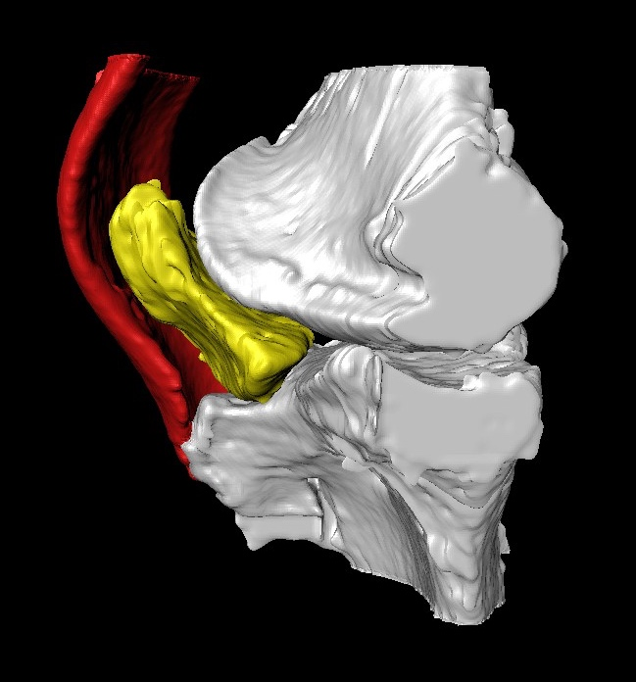
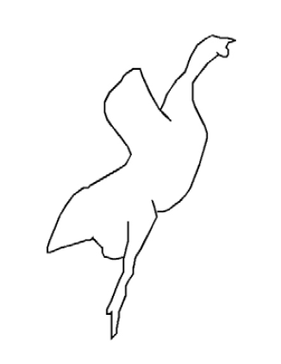
Ongoing studies – Combined Morphological and Functional Studies
Similar protocol – active vs. inactive groups during growth
  MRI Assessment of moment arms underway
  Running Energetics: Active birds have a similar sub-max energy cost of locomotion.
  Vertical Jumping: Active birds have greater max vertical GRF and greater acceleration (does not appear accounted for by muscle size)
Notes:
The results shown also beg the question - do they make a difference functionally? While we do not both detailed musculoskeletal measurements and functional data on these birds, we have a new group of birds under a similar protocol in hopes to link morphology and function. We plan to gather muscle architecture data and moment arm data via high-res MRI in attempt to link morphology and function.
So far, we have assessed both high acceleration function with jumping, and energetics during running. We have also found that the active group have a lower energy cost of running compared to the sedentary group. We have seen that the active group produce substantially greater ground reaction forces during maximal jumping, and produce higher accelerations.
So while we do not yet know the links between muscle morphology and these functional differences, but these data offer exciting glimpse into form-function relationships, and how these may be altered due to developmental plasticity.

Slide 17
Conclusion
FOR THE FIRST TIME WE SHOW THAT:
  High-acceleration training during growth allows musculoskeletal system to adapt to movements requiring power over long muscle excursions.
Long-term goal:
Can active adulthood reverse effects of inactive childhood?
Notes:
In conclusion, we show for the first time that high-acceleration training during growth results in the musculoskeletal system to adapt in a manner that minimizes F-L and F-V constraints of muscle. Our long-term goal, which we are currently embarking on, is investigate if the disadvantages in morphology from an inactive childhood persist into adulthood, and if so, whether they can be recovered with an active adulthood.

Slide 18
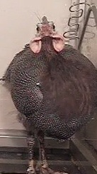

Acknowledgements
Questions?
Tim Ryan, PhD
Thomas Neuberger, PhD
Emily Southmayd, M.S.
Adam De Boef
Leighann Warholak
Justin Csaszar
Paige Reynolds
Sina Pooresmaeil
Tyler Faimont
Funding
Center for Human Evolution and Diversity Seed Grant

